Slide 1
Data Binning
By Or Dinar, Liad Ackerman and Maayan Ben Zion
Guided by Dr. Adi Akavia

Slide 2
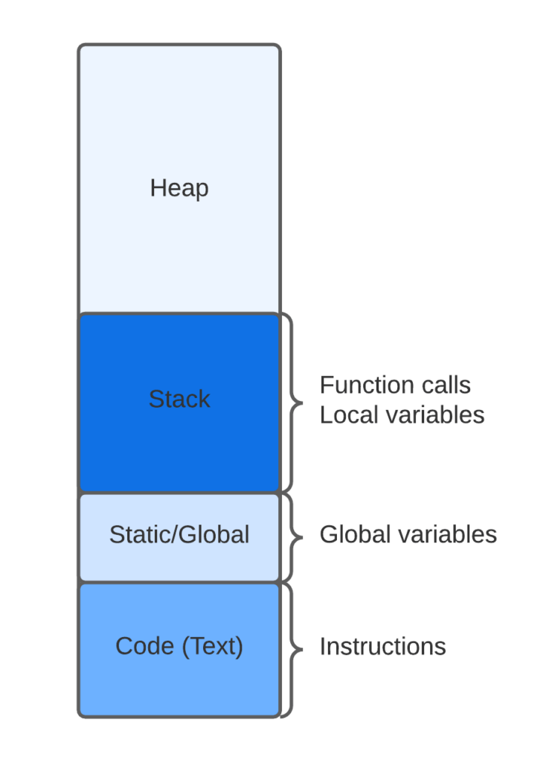

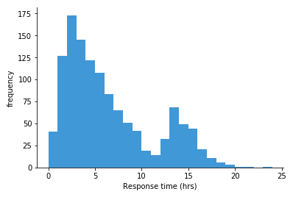
Topics
Balanced Allocation
Cuckoo Hashing
Data Binning

Slide 3
Data Generalization
Data generalisation involves sorting sensitive columns into bins or groups for analysis, removing specifics and creating a more generalised view. This technique, in combination with other pseudonymisation methods, is particularly effective for large datasets.
Balanced Allocation
Cuckoo Hashing
Data Binning

Slide 4
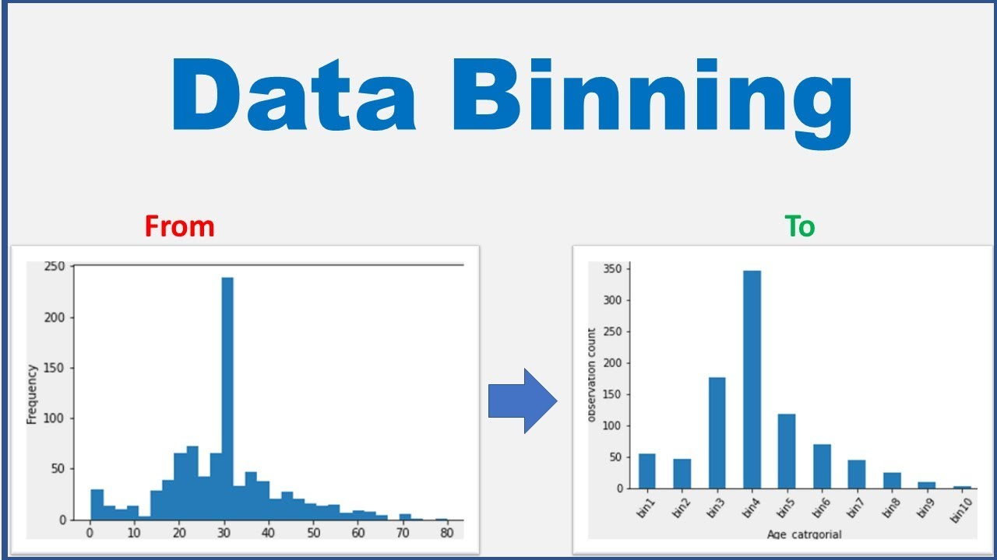
Definition of Data Binning
‘Discretization or “binning” is a common form of data preprocessing, aimed at grouping continuous or numerical values into a smaller number of bins (buckets).’
Balanced Allocation
Cuckoo Hashing
Data Binning

Slide 5
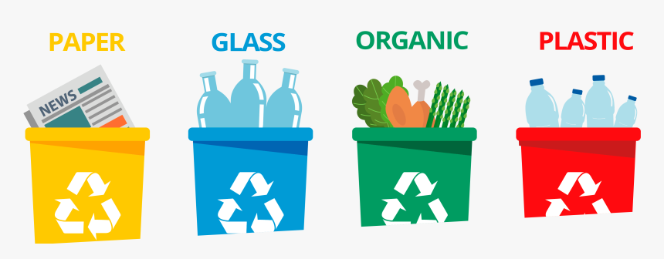
Examples of Data Binning
Balanced Allocation
Cuckoo Hashing
Data Binning
Recycling:
Glass
Plastic
Paper
Organic
Metals
Electronic Waste

Slide 6
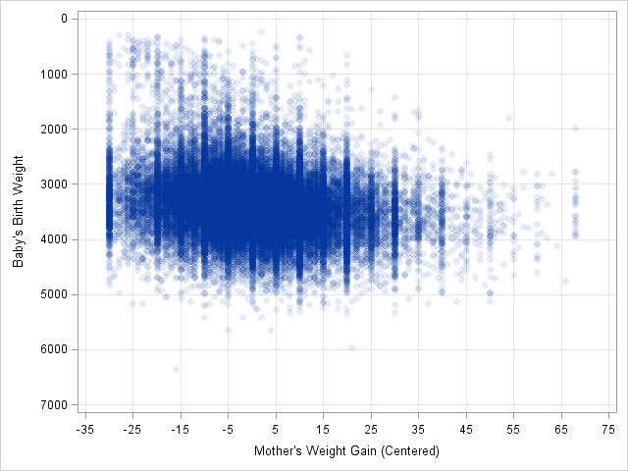
Examples of Data Binning
Balanced Allocation
Cuckoo Hashing
Data Binning
Binning an extensive amount of data into discrete values.

Slide 7
Steps
Balanced Allocation
Cuckoo Hashing
Data Binning
1
Identify the range of all values
2
Choose a suitable Binning method
3
Choose the amount of bins
4
Sort the data in the defined range
5
Analyze the data

Slide 8
Types of Binning
Balanced Allocation
Cuckoo Hashing
Data Binning
Supervised Binning
Unsupervised Binning
design

Slide 9
Binning methods
Balanced Allocation
Cuckoo Hashing
Data Binning
Equal-Width Binning
Equal-Frequency Binning
Entropy-Based Binning
Custom Binning
Quantile Binning
Optimal Binning
design

Slide 10
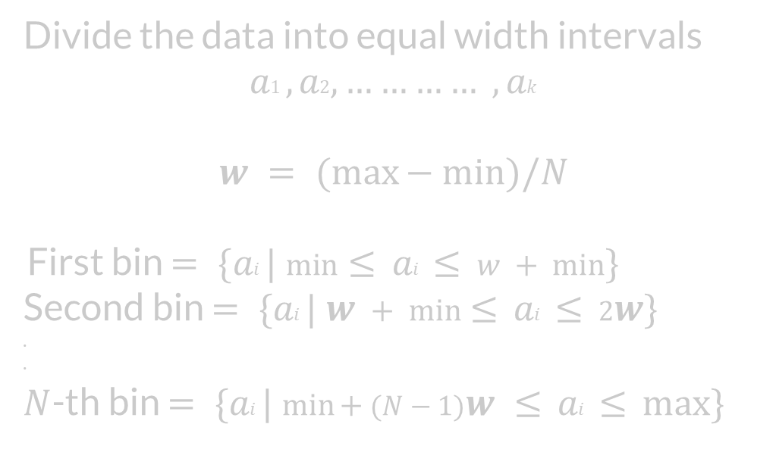
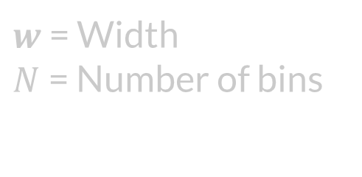
Equal-Width Binning
Balanced Allocation
Cuckoo Hashing
Data Binning
design

Slide 11
Equal-Width Binning
Balanced Allocation
Cuckoo Hashing
Data Binning
Cons | Pros
Loss of Information Impact of width selection Sensitivity to Data Distribution | Simplicity Interpretability Outlier Insensitivity

Slide 12
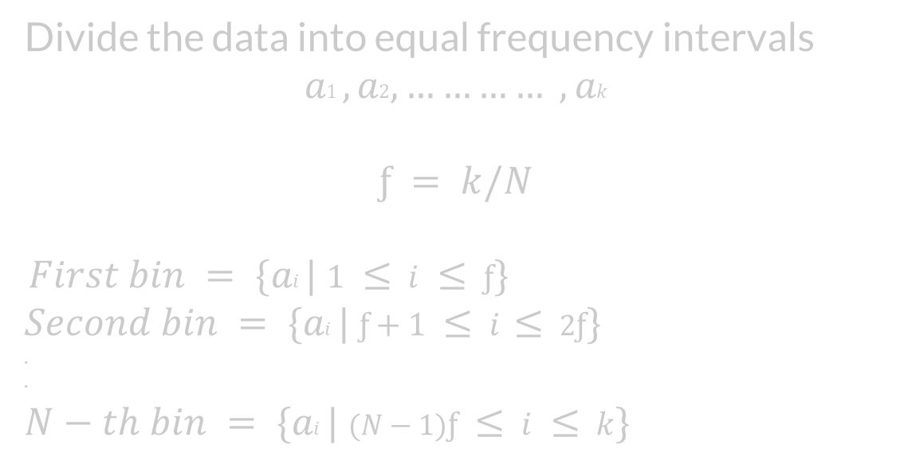
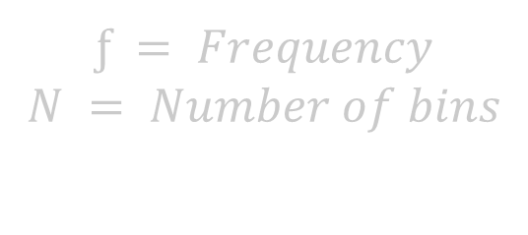
Equal-Frequency Binning
Balanced Allocation
Cuckoo Hashing
Data Binning
design

Slide 13
Equal-Width Binning
Balanced Allocation
Cuckoo Hashing
Data Binning
Cons | Pros
Loss of Information Impact of Bin selection Sensitivity to Data Distribution | Balanced Representation Reduce Impact of Outliers Interpretability

Slide 14
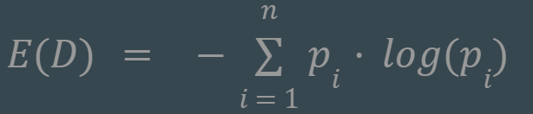
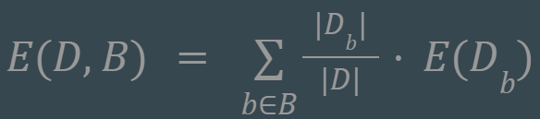

Entropy-Based Binning
Balanced Allocation
Cuckoo Hashing
Data Binning
find bin boundaries that maximize the information gain or minimize the uncertainty within each bin.
Calculate Entropy:
Calculate Entropy given a bin:
3. Calculate Information gain:

Slide 15
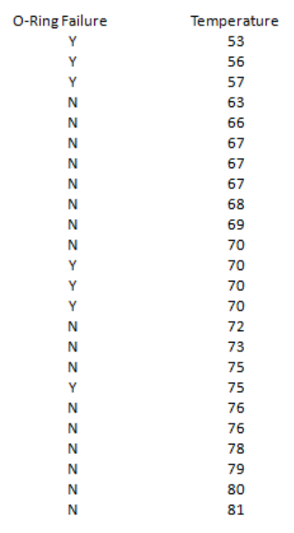
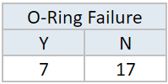
Entropy-Based Binning
Balanced Allocation
Cuckoo Hashing
Data Binning
Calculate Entropy:
E(Failure) = E(7,17) = E(0.29,0.71)
= -[0.29∙log(0.29) + 0.71∙log(0.71)]
= 0.871

Slide 16
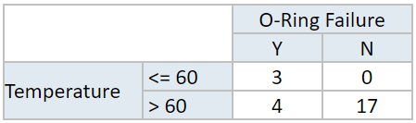
Entropy-Based Binning
Balanced Allocation
Cuckoo Hashing
Data Binning
2. Calculate Entropy given a bin:
E(Failure,Temp) = P(≤60)∙E(3,0) + P(>60)∙E(4,17)
= (3/24)∙0 + (21/24)∙0.7
= 0.615

Slide 17
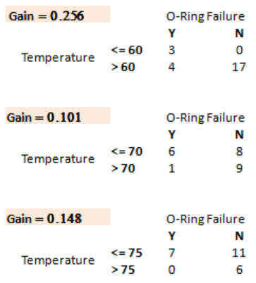
Entropy-Based Binning
Balanced Allocation
Cuckoo Hashing
Data Binning
3. Calculate Information gain:

Slide 18
Hashing
Balanced Allocation
Data Binning
Cuckoo Hashing
Keys
Hash Function
Hash Table
Abraham
0
John
1
2
Moshe
John
3
Abraham
4
Boris
5
6
Moshe
7
Boris

Slide 19



Hashing - Operations
Balanced Allocation
Data Binning
Cuckoo Hashing
Insert
Get
Delete
All operations’ complexity is O(n) when using Linked Lists
All operations’ complexity is O(logn) when using BST

Slide 20


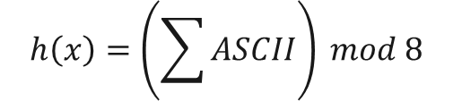


Hashing - Example
Balanced Allocation
Data Binning
Cuckoo Hashing
Keys
Hash Function
Hash Table
0
$$h\left(John\right)=7$$
John
1
2
$$h\left(Moshe\right)=4$$
Moshe
3
$$h\left(Abraham\right)=4$$
Abraham
4
$$h\left(Boris\right)=7$$
Boris
5
6
7
$$h\left(x\right)=\left(\sum{ASCII}\right) mod 8$$

Slide 21
Hashing - Example
Balanced Allocation
Data Binning
Cuckoo Hashing
Keys
Hash Function
Hash Table
Insert(John)
0
$$h\left(John\right)=7$$
John
1
2
$$h\left(Moshe\right)=4$$
Moshe
3
$$h\left(Abraham\right)=4$$
Abraham
4
$$h\left(Boris\right)=7$$
Boris
5
6
John
7
$$h\left(x\right)=\left(\sum{ASCII}\right) mod 8$$

Slide 22
Hashing - Example
Balanced Allocation
Data Binning
Cuckoo Hashing
Keys
Hash Function
Hash Table
Insert(Moshe)
0
$$h\left(John\right)=7$$
John
1
2
$$h\left(Moshe\right)=4$$
Moshe
3
$$h\left(Abraham\right)=4$$
Abraham
4
Moshe
$$h\left(Boris\right)=7$$
Boris
5
6
John
7
$$h\left(x\right)=\left(\sum{ASCII}\right) mod 8$$

Slide 23
Hashing - Example
Balanced Allocation
Data Binning
Cuckoo Hashing
Keys
Hash Function
Hash Table
Insert(Abraham)
0
$$h\left(John\right)=7$$
John
1
2
$$h\left(Moshe\right)=4$$
Moshe
3
$$h\left(Abraham\right)=4$$
Abraham
Abraham
4
Moshe
$$h\left(Boris\right)=7$$
Boris
5
6
John
7
$$h\left(x\right)=\left(\sum{ASCII}\right) mod 8$$

Slide 24
Hashing - Example
Balanced Allocation
Data Binning
Cuckoo Hashing
Keys
Hash Function
Hash Table
Insert(Boris)
0
$$h\left(John\right)=7$$
John
1
2
$$h\left(Moshe\right)=4$$
Moshe
3
$$h\left(Abraham\right)=4$$
Abraham
Abraham
4
Moshe
$$h\left(Boris\right)=7$$
Boris
5
6
Boris
7
John
$$h\left(x\right)=\left(\sum{ASCII}\right) mod 8$$

Slide 25
Cuckoo Hashing
Balanced Allocation
Data Binning
Cuckoo Hashing
Collision is key

Slide 26
Cuckoo Hashing
Balanced Allocation
Data Binning
Cuckoo Hashing
All operations remain
In case of collision
Complexity changes

Slide 27
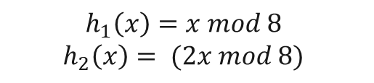

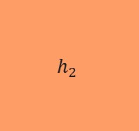

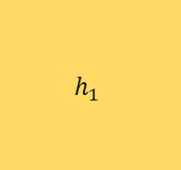




Cuckoo Hashing
Balanced Allocation
Data Binning
Cuckoo Hashing
Keys
Hash Functions
Hash Table 1
Hash Table 2
$$h_{1}\left(51\right)=3$$
51
$$h_{1}$$
0
0
1
1
$$h_{1}\left(133\right)=5$$
133
2
2
$$h_{1}\left(662\right)=6$$
662
3
3
$$h_{1}\left(534\right)=6$$
534
$$h_{2}$$
4
4
5
5
$$h_{1}\left(23\right)=7$$
23
6
6
$$h_{1}\left(445\right)=5$$
445
7
7
$$h_{1}\left(x\right)=x mod 8$$
$$h_{2}\left(x\right)= (2x mod 8)$$

Slide 28
Cuckoo Hashing
Balanced Allocation
Data Binning
Cuckoo Hashing
Keys
Hash Functions
Hash Table 1
Hash Table 2
Insert(534)
$$h_{1}\left(51\right)=3$$
51
$$h_{1}$$
0
0
1
1
$$h_{1}\left(133\right)=5$$
133
2
2
$$h_{1}\left(662\right)=6$$
662
51
3
3
$$h_{1}\left(534\right)=6$$
534
4
4
534
$$h_{2}$$
5
5
133
$$h_{1}\left(23\right)=7$$
23
6
6
662
$$h_{1}\left(445\right)=5$$
445
7
7
Collision
$$h_{1}\left(x\right)=x mod 8$$
$$h_{2}\left(x\right)= (2x mod 8)$$

Slide 29

Cuckoo Hashing
Balanced Allocation
Data Binning
Cuckoo Hashing
Keys
Hash Functions
Hash Table 1
Hash Table 2
Insert(534)
$$h_{1}\left(51\right)=3$$
51
$$h_{1}$$
0
0
1
1
$$h_{1}\left(133\right)=5$$
133
2
2
$$h_{1}\left(662\right)=6$$
662
51
3
3
$$h_{1}\left(534\right)=6$$
534
$$h_{2}$$
4
4
5
5
133
$$h_{1}\left(23\right)=7$$
23
6
6
534
$$h_{1}\left(445\right)=5$$
445
7
7
Collision
$$h_{2}\left(662\right)= \left(2x mod 8\right)=4$$
$$h_{1}\left(x\right)=x mod 8$$
$$h_{2}\left(x\right)= (2x mod 8)$$
662

Slide 30
Cuckoo Hashing
Balanced Allocation
Data Binning
Cuckoo Hashing
Keys
Hash Functions
Hash Table 1
Hash Table 2
Insert(534)
$$h_{1}\left(51\right)=3$$
51
$$h_{1}$$
0
0
1
1
$$h_{1}\left(133\right)=5$$
133
2
2
$$h_{1}\left(662\right)=6$$
662
51
3
3
4
4
$$h_{1}\left(534\right)=6$$
534
$$h_{2}$$
662
5
5
133
$$h_{1}\left(23\right)=7$$
23
6
6
534
$$h_{1}\left(445\right)=5$$
445
7
7
Collision
$$h_{2}\left(662\right)= \left(2x mod 8\right)=4$$
$$h_{1}\left(x\right)=x mod 8$$
$$h_{2}\left(x\right)= (2x mod 8)$$

Slide 31
Cuckoo Hashing
Balanced Allocation
Data Binning
Cuckoo Hashing
Keys
Hash Functions
Hash Table 1
Hash Table 2
Insert(23)
$$h_{1}\left(51\right)=3$$
51
$$h_{1}$$
0
0
1
1
$$h_{1}\left(133\right)=5$$
133
2
2
$$h_{1}\left(662\right)=6$$
662
51
3
3
4
4
$$h_{1}\left(534\right)=6$$
534
$$h_{2}$$
662
5
5
133
$$h_{1}\left(23\right)=7$$
23
6
6
534
$$h_{1}\left(445\right)=5$$
445
7
7
23
$$h_{1}\left(x\right)=x mod 8$$
$$h_{2}\left(x\right)= (2x mod 8)$$

Slide 32

Cuckoo Hashing
Balanced Allocation
Data Binning
Cuckoo Hashing
Keys
Hash Functions
Hash Table 1
Hash Table 2
Insert(445)
$$h_{1}\left(51\right)=3$$
51
$$h_{1}$$
0
0
1
1
$$h_{1}\left(133\right)=5$$
133
2
2
$$h_{1}\left(662\right)=6$$
662
51
3
3
4
662
$$h_{1}\left(534\right)=6$$
534
$$h_{2}$$
4
5
5
445
$$h_{1}\left(23\right)=7$$
23
6
6
534
$$h_{1}\left(445\right)=5$$
445
7
7
23
Collision
$$h_{2}\left(133\right)= \left(2x mod 8\right)=2$$
$$h_{1}\left(x\right)=x mod 8$$
$$h_{2}\left(x\right)= (2x mod 8)$$
133

Slide 33
Cuckoo Hashing
Balanced Allocation
Data Binning
Cuckoo Hashing
Keys
Hash Functions
Hash Table 1
Hash Table 2
Insert(445)
$$h_{1}\left(51\right)=3$$
51
$$h_{1}$$
0
0
1
1
$$h_{1}\left(133\right)=5$$
133
2
133
2
$$h_{1}\left(662\right)=6$$
662
51
3
3
4
662
$$h_{1}\left(534\right)=6$$
534
$$h_{2}$$
4
5
5
445
$$h_{1}\left(23\right)=7$$
23
6
6
534
$$h_{1}\left(445\right)=5$$
445
7
7
23
Collision
$$h_{2}\left(133\right)= \left(2x mod 8\right)=2$$
$$h_{1}\left(x\right)=x mod 8$$
$$h_{2}\left(x\right)= (2x mod 8)$$

Slide 34
Cuckoo Hashing
Balanced Allocation
Data Binning
Cuckoo Hashing
Keys
Hash Functions
Hash Table 1
Hash Table 2
$$h_{1}\left(51\right)=3$$
51
$$h_{1}$$
0
0
1
1
$$h_{1}\left(133\right)=5$$
133
2
133
2
$$h_{1}\left(662\right)=6$$
662
51
3
3
4
662
$$h_{1}\left(534\right)=6$$
534
$$h_{2}$$
4
5
5
445
$$h_{1}\left(23\right)=7$$
23
6
6
534
$$h_{1}\left(445\right)=5$$
445
7
7
23
$$h_{1}\left(x\right)=x mod 8$$
$$h_{2}\left(x\right)= (2x mod 8)$$

Slide 35

Cuckoo Hashing
Balanced Allocation
Data Binning
Cuckoo Hashing
Keys
Hash Functions
Hash Table 1
Hash Table 2
$$h_{1}\left(51\right)=3$$
51
$$h_{1}$$
0
0
1
1
$$h_{1}\left(133\right)=5$$
133
2
133
2
$$h_{1}\left(662\right)=6$$
662
51
3
3
4
662
$$h_{1}\left(534\right)=6$$
534
$$h_{2}$$
4
5
5
445
$$h_{1}\left(23\right)=7$$
23
6
6
534
534
$$h_{1}\left(445\right)=5$$
445
7
7
23
$$h_{1}\left(22\right)=6$$
22
22
$$h_{1}\left(x\right)=x mod 8$$
$$h_{2}\left(x\right)= (2x mod 8)$$

Slide 36

Cuckoo Hashing
Balanced Allocation
Data Binning
Cuckoo Hashing
Keys
Hash Functions
Hash Table 1
Hash Table 2
Insert(445)
$$h_{1}\left(51\right)=3$$
51
$$h_{1}$$
0
0
1
1
$$h_{1}\left(133\right)=5$$
133
2
133
2
$$h_{1}\left(662\right)=6$$
662
51
3
3
4
4
662
$$h_{1}\left(534\right)=6$$
534
$$h_{2}$$
662
5
5
445
$$h_{1}\left(23\right)=7$$
23
6
6
22
$$h_{1}\left(445\right)=5$$
445
7
7
23
$$h_{1}\left(22\right)=6$$
22
$$h_{2}\left(534\right)= \left(2x mod 8\right)=4$$
$$h_{1}\left(x\right)=x mod 8$$
$$h_{2}\left(x\right)= (2x mod 8)$$
Collision
534

Slide 37

Cuckoo Hashing
Balanced Allocation
Data Binning
Cuckoo Hashing
Keys
Hash Functions
Hash Table 1
Hash Table 2
Insert(445)
$$h_{1}\left(51\right)=3$$
51
$$h_{1}$$
0
0
1
1
$$h_{1}\left(133\right)=5$$
133
2
133
2
$$h_{1}\left(662\right)=6$$
662
51
3
3
4
534
4
$$h_{1}\left(534\right)=6$$
534
$$h_{2}$$
662
5
5
445
$$h_{1}\left(23\right)=7$$
23
6
6
22
$$h_{1}\left(445\right)=5$$
445
7
7
23
$$h_{1}\left(22\right)=6$$
22
$$h_{1}\left(662\right)= \left(x mod 8\right)=6$$
$$h_{1}\left(x\right)=x mod 8$$
$$h_{2}\left(x\right)= (2x mod 8)$$
Collision
662

Slide 38
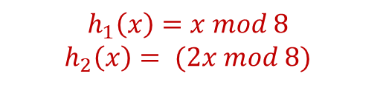

Cuckoo Hashing
Balanced Allocation
Data Binning
Cuckoo Hashing
Keys
Hash Functions
Hash Table 1
Hash Table 2
Insert(445)
$$h_{1}\left(51\right)=3$$
51
$$h_{1}$$
0
0
1
1
$$h_{1}\left(133\right)=5$$
133
2
133
2
$$h_{1}\left(662\right)=6$$
662
51
3
3
4
534
4
$$h_{1}\left(534\right)=6$$
534
$$h_{2}$$
662
5
5
445
$$h_{1}\left(23\right)=7$$
23
6
6
22
$$h_{1}\left(445\right)=5$$
445
7
7
23
$$h_{1}\left(22\right)=6$$
22
$$h_{1}\left(662\right)= \left(x mod 8\right)=6$$
$$h_{1}\left(x\right)=x mod 8$$
$$h_{2}\left(x\right)= (2x mod 8)$$
Collision
662

Slide 39
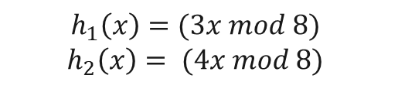

Cuckoo Hashing
Balanced Allocation
Data Binning
Cuckoo Hashing
Keys
Hash Functions
Hash Table 1
Hash Table 2
Insert(445)
$$h_{1}\left(51\right)=3$$
51
$$h_{1}$$
0
0
1
1
$$h_{1}\left(133\right)=5$$
133
2
133
2
$$h_{1}\left(662\right)=6$$
662
51
3
3
4
534
4
$$h_{1}\left(534\right)=6$$
534
$$h_{2}$$
662
5
5
445
$$h_{1}\left(23\right)=7$$
23
6
6
22
$$h_{1}\left(445\right)=5$$
445
7
7
23
$$h_{1}\left(22\right)=6$$
22
$$h_{1}\left(662\right)= \left(3x mod 8\right)=2$$
$$h_{1}\left(x\right)=(3x mod 8)$$
$$h_{2}\left(x\right)= (4x mod 8)$$
662

Slide 40
Cuckoo Hashing
Balanced Allocation
Data Binning
Cuckoo Hashing
Keys
Hash Functions
Hash Table 1
Hash Table 2
Insert(445)
$$h_{1}\left(51\right)=3$$
51
$$h_{1}$$
0
0
1
1
$$h_{1}\left(133\right)=5$$
133
2
133
662
2
$$h_{1}\left(662\right)=6$$
662
51
3
3
4
534
4
$$h_{1}\left(534\right)=6$$
534
$$h_{2}$$
662
5
5
445
$$h_{1}\left(23\right)=7$$
23
6
6
22
$$h_{1}\left(445\right)=5$$
445
7
7
23
$$h_{1}\left(22\right)=6$$
22
$$h_{1}\left(662\right)= \left(3x mod 8\right)=2$$
$$h_{1}\left(x\right)=(3x mod 8)$$
$$h_{2}\left(x\right)= (4x mod 8)$$

